Slide 1
MATHEMATICS IN GAMING INDUSTRY

Slide 2
INTRODUCTION
Math = The Foundation of Game Design

Slide 3
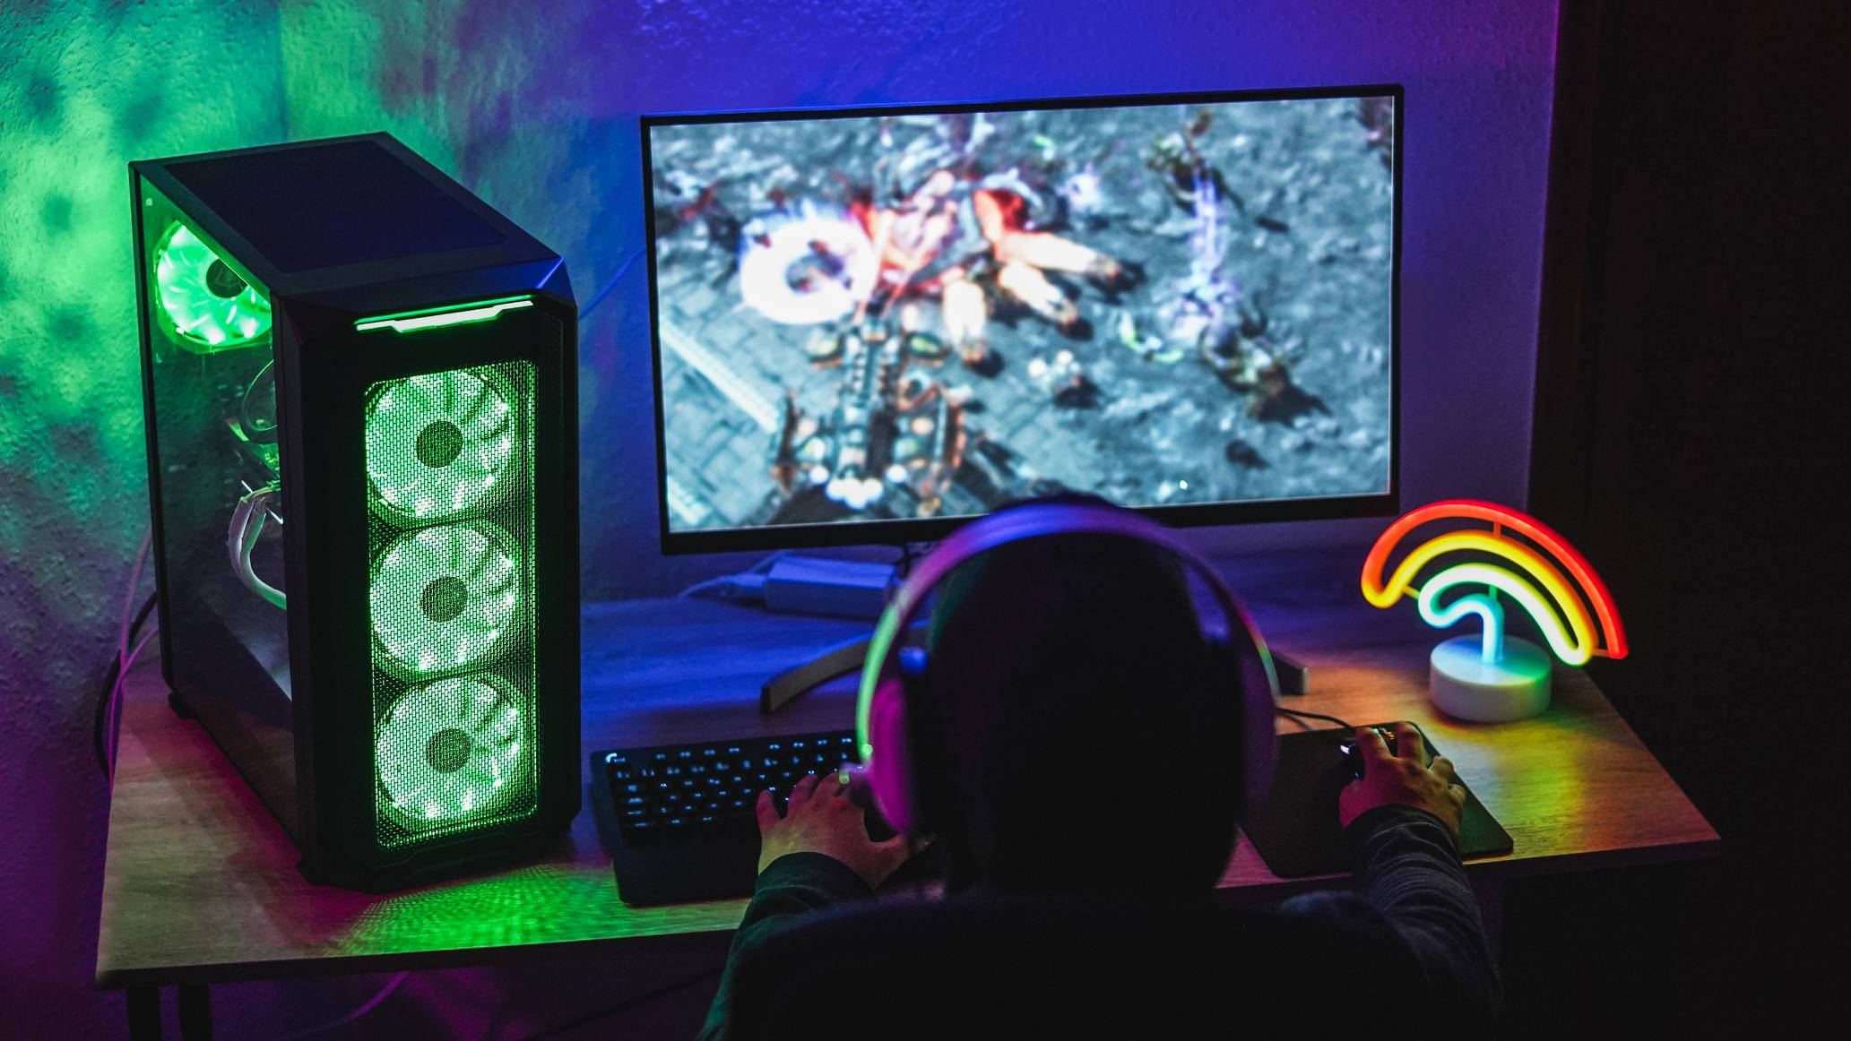
Simulation games are games that try to make something as realistic as possible. For instance, Flight Sims are computer games which try to realistically simulate flying an aeroplane or helicopter. Two games of this sort are Microsoft Flight Simulator and Red Baron . Space sims are like flight sims, but with spaceships instead of planes. For instance, Wing Commander or X-Wing vs. Tie Fighter . Racing games are games which simulate driving different sort of cars. For instance, Need for Speed , NASCAR Racing , Gran Turismo or Driver .

Slide 4
Most of the time the math you learned in high school and college is no different than what was used to design a game.
To name a few, some of the common branches of math utilized in game development include:
Algebra
Trigonometry
Calculus
Linear Algebra
Discrete Mathematics
Applied Mathematics

Slide 5
More specific elements of math almost always used in games includes:
MATRICES
DELTA TIME
UNIT AND SCALING VECTORS
DOT AND CROSS PRODUCTS
SCALAR MANIPULATION

Slide 6
History
The history of video games began in the 1950s and 1960s as computer scientists began designing simple games and simulations on mainframe computers, with MIT's Spacewar! in 1962 as one of the first such games to be played with a video display.

Slide 7
GEOMETRY, VECTORS AND TRANFORMATIONS

Slide 8
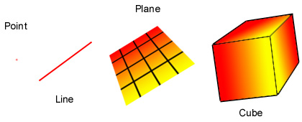
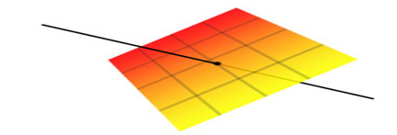
GEOMETRY
Geometry is the study of shapes of various sort.
The simplest shape is the point .
Another simple shape is a straight line . A straight line is just the simplest shape joining two points together.
A plane is a more complicated shape, it is a flat sheet, like a piece of paper or a wall.

Slide 9
GEOMETRY IN GAMING
Video games are heavily based on patterns to present motion within the video game. These patterns are all based on the patterns within geometric shapes to give the video game action and the three dimensional look. This provides more reality to today's video games; rather than the original video games like Pong, Space Invaders, Pacman, and other early games that came out in the 1970s. Although these games relied heavily on geometric patterns and shapes, the games could only present a two dimensional view of the game.

Slide 10
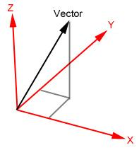
VECTORS
A vector is a mathematical way of representing a point.
A vector is 3 numbers, usually called x, y and z.
Geometrically, we can picture a vector as a directed line segment, whose length is the magnitude of the vector and with an arrow indicating the direction.
The direction of the vector is from its tail to its head.

Slide 11
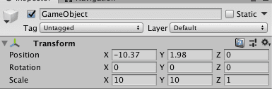
VECTOR IN GAMING
In game development, vectors have two or three dimensions (depending on whether you are making a 2D or 3D game) and are generally used to represent geometrical properties of objects within the game world (rotation, position, etc.).

Slide 12
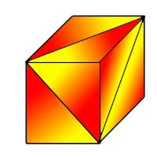
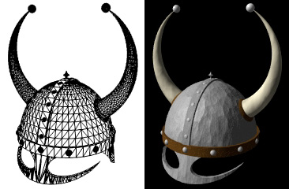
3D GRAPHICS
The basic idea of 3D graphics is to turn a mathematical description of a world into a picture of what that world would look like to someone inside the world. The mathematical description could be in the form of a list, for instance: there is a box with centre (2,4,7) and sides of length 3, the color of the box is a bluish grey . To turn this into a picture, we also need to describe where the person is and what direction they are looking

Slide 13
3D MODELLING SOFTWARE
Few of the best 3D Modelling softwares:
Substance Painter: is taking over the world of 3D model and asset texturing. When you’ve made a model it starts out all grey and you have to paint in textures
Autodesk Maya: Autodesk Maya is industry standard tool for just about everything 3D and one of the most powerful tools to have in your arsenal.
Autodesk Mudbox: Mudbox specializes in fast and intuitive digital sculpting and painting. Basically a big fun sketchpad to try out character ideas in 3D.
And many more.

Slide 14
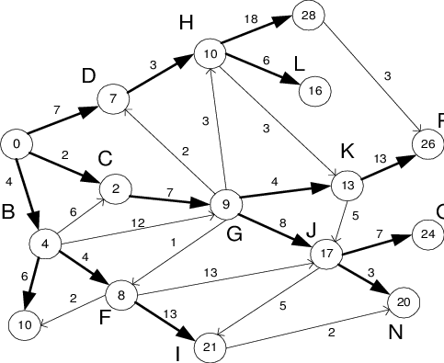
Nodes , Edges And Graphs
When developing the AI for games, one of the most common uses of graphs is to represent a network of paths an agent can use to navigate around its environment.
Each node in a navgraph usually represents the position of a key area or object within the environment and each edge represents the connections between those points.

Slide 15
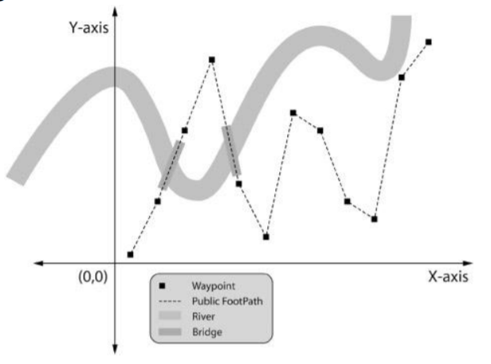
A navigation graph, or navgraph, is an abstraction of all the locations in a game environment the game agents may visit and of all the connections between those points.
Consequently, a well-designed navgraph is a data structure embodying all the possible paths through the game environment and is therefore extremely handy for helping your game agents decide how to get from A to B.
This approach enables game agents to easily calculate paths that avoid water, prefer traveling on roads to mud, and meander around mountains.

Slide 16
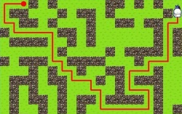
Path Finding
Pathfinding or pathing is the plotting, by a computer application, of the shortest route between two points. It is a more practical variant of solving mazes.
The pathfinding system has the responsibility of understanding the possibilities for movement within the virtual world.

Slide 17
Examples of Path Finding Algorithm
Dijkstra's algorithm
Dijkstra’s was introduced in 1970 by Edsger Wybe Dijkstra as one of the best path algorithms.
Dijkstra’s algorithm is a classic graph search algorithm which can find the shortest path between two points on the graph.
It has been applied in many areas such as network routing, public transportation, and logistics .

Slide 18
What can math do in game design?
Fluid water simulation.
Animation.
Algorithms.
Game engine architecture.
Gameplay scripting. (walking, shooting, jumping)
Physics programming (inertia, friction, etc).
Graphics/Shaders programming (matrices,etc).
Handling Polygon rendering

Slide 19
Here Are Some Examples
Those bullets flying over your head in Call of Duty: ? Math.
· Ocean waves crashing nicely against your boat in Assassin's Creed? Math.
Sonic being able to run fast and Mario being able to jump? Math.
Drifting around that corner in Need for Speed at 80mph? Math.

Slide 20
CONCLUSION
A careful observation will make it clear that there is a bright future for this gaming industry.
The gaming industry is expected to have a statistical worth of about $300 billion by 2025.
Improvements have been made also in cross play where games use PLAYSTATION and XBOX can stream games to a PC
The first nine months of 2020 saw India rise to the number 1 spot in mobile games downloads worldwide, clocking 7.3 billion installs and ranking 17% market share of the installs volume, as per Sensors Tower data
HENCE MATHS IS EVERYTHING WHEN IT COMES TO GAMING.

Slide 21
PRESENTED BY:
NAVANIDHI NAYAK
SANAT K S
PARISHKAR SINGH
SAHANA TAVARI

